Slide 1
FACE EMOTION RECOGNITIONWEB App
USING DEEP LEARNING AND FLASK

Slide 2
Application of face Emotion detection
Assess personality traits in interviews.
Product testing and client feedback.
Enhances customer service.
Patient monitoring in medical .

Slide 3
List of used technologies :
FLASK
HTML AND CSS
Convolutional neural network
PYTHON module :
tensorflow
matplotlib
keras
Numpy

Slide 4
Introduction : DATASET
USING KAGGLE FER2013 dataset for build the data model .
The FER-2013 dataset was created by gathering the results of a Google image search of each emotion and synonyms of the emotions. The images in FER-2013 consist of both posed and un-posed headshots.
Emotion class: is a digit between 0 to 6 and represents the emotion depicted in the corresponding picture. Each emotion is mapped to an integer as shown below.
0- 'Angry’ 1-'Disgust’ 2-'Fear’ 3-'Happy’ 4-'Sad’ 5-'Surprise’ 6-'Neutral

Slide 5
Flask :
Flask is a lightweight Python web framework that provides useful tools and features for creating web applications in the Python Language.
used for developing web applications.
There is a built-in development server and a fast debugger provided.
Lightweight.

Slide 6
Convolutional neural network
Convolutional Neural Network (CNN) is used to extract features from images to detect emotions which help to build the deep learning model.
CNNs is that they can learn from raw pixel data, without requiring any manual feature engineering or preprocessing. This means that they can automatically discover and adapt to the most salient characteristics of the images, such as edges, shapes, colors, textures, and objects.

Slide 7
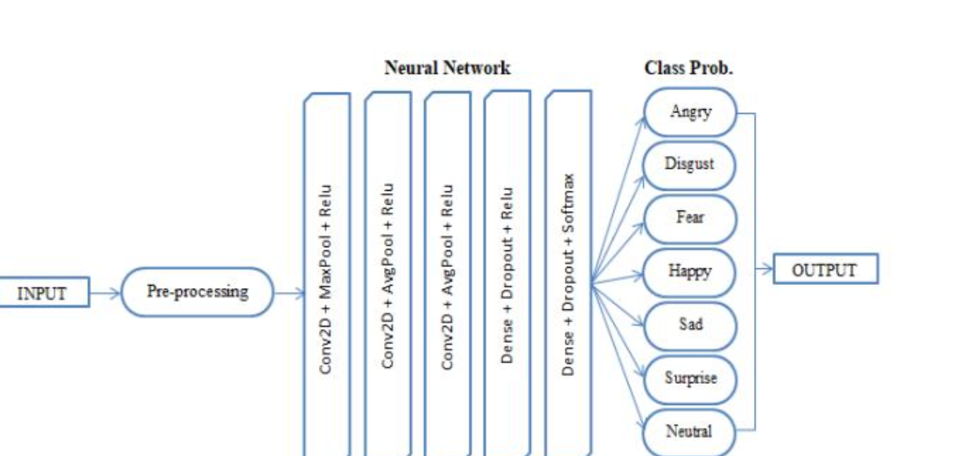

Slide 9
Thank you
Name :Shailesh Kumar
Roll no : 45
University roll no : 2018718
Sem : 6

